Slide 3
flow
path of flukes
orientation of fin
α
path of animal
thrust
drag
lift

Slide 4
flow
path of flukes
orientation of fin
α
path of animal
thrust
drag
lift

Slide 5
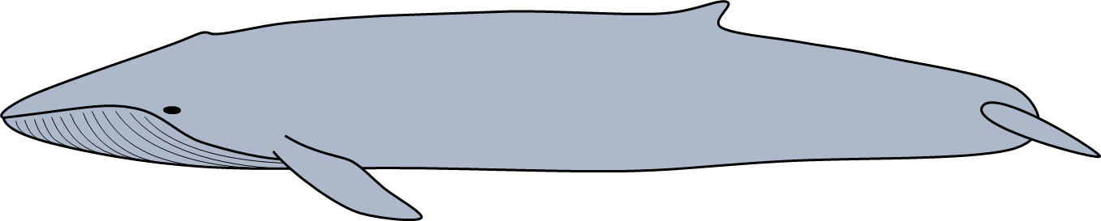
flow
path of flukes
orientation of fin
α
drag
path of animal
thrust
lift

Slide 6
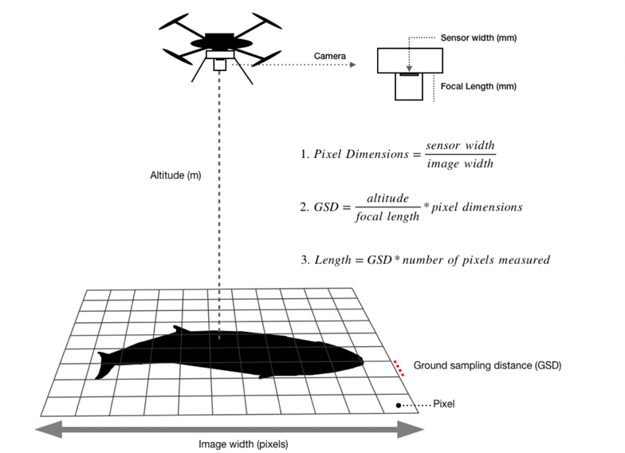
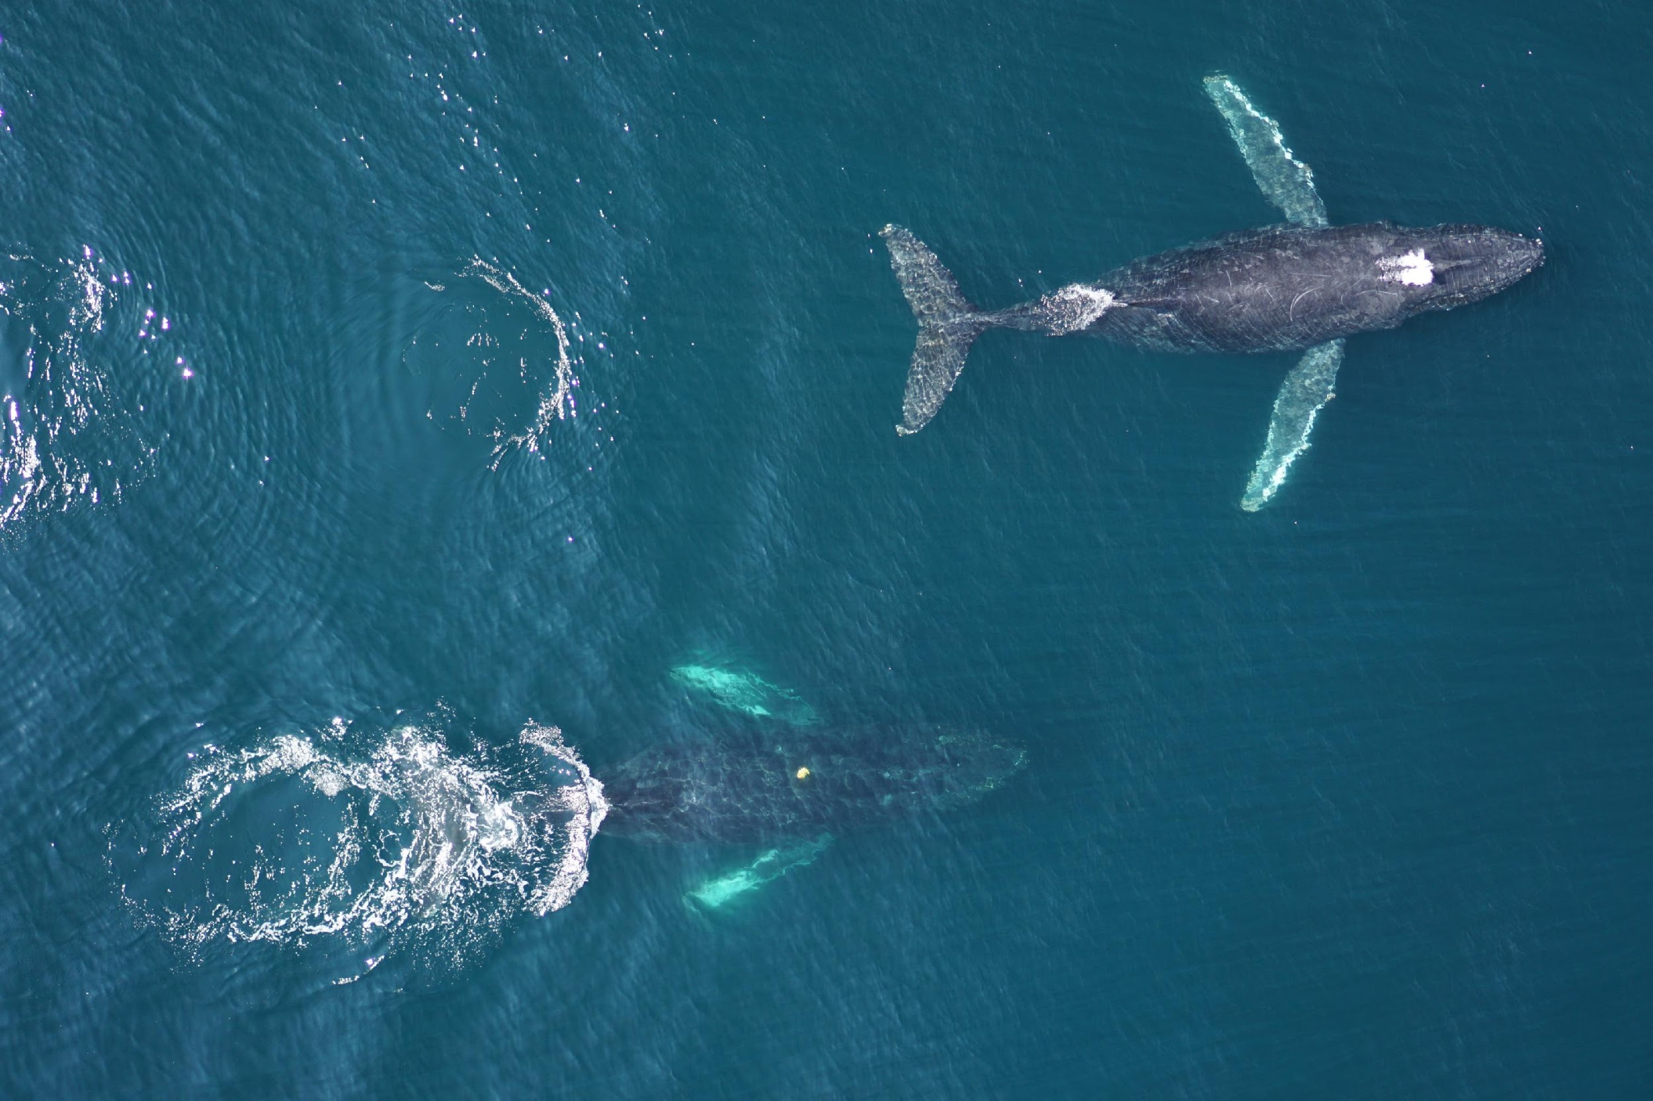
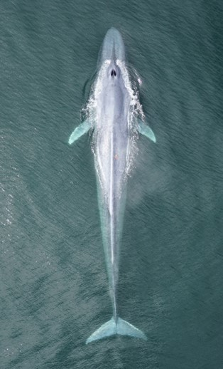
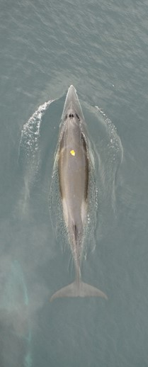
Blue
Minke

